Slide 1
Iris Flower Classification using Machine Learning
Oasis Infobyte Internship Project
our Name
Internship Domain
Date

Slide 2
Content
The objective of this project is to build a Machine Learning model that can classify iris flowers into different species based on their measurements.
Setosa
Versicolor
Virginica

Slide 3
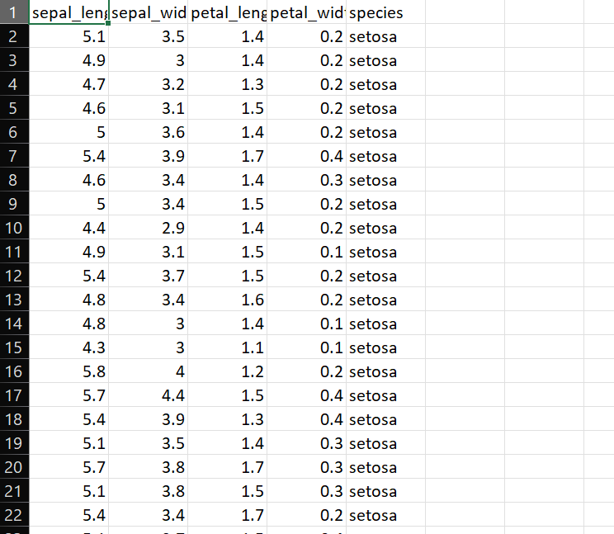
About Dataset
The Iris dataset contains flower measurements for three different iris species.
Features:
Sepal Length
Sepal Width
Petal Length
Petal Width
Target:
Species Classification

Slide 4
Technologies Used
Tools & Libraries Used:
Python
Pandas
NumPy
Matplotlib
Seaborn
Scikit-learn
Google Colab

Slide 5
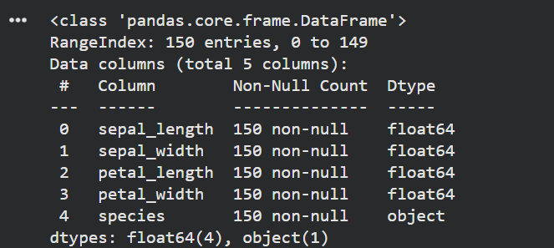
Data Exploration
Performed exploratory data analysis to understand dataset structure, distributions, and species relationships.

Slide 6
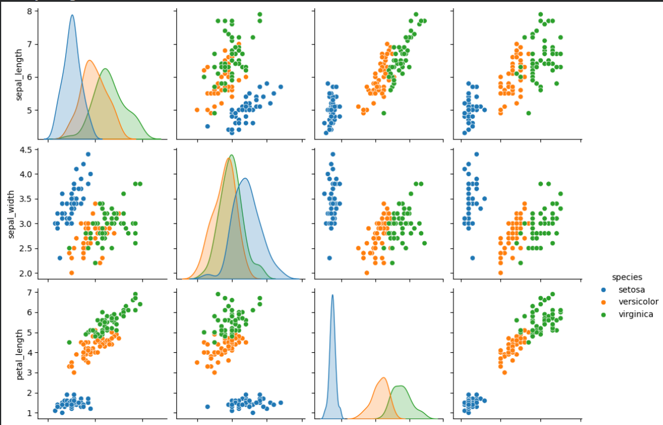
Data Visualization
Used Seaborn pairplot visualization to identify patterns and separations between iris species.

Slide 7
Machine Learning Model
Used K-Nearest Neighbors (KNN) algorithm for classification.
Steps:
Data Splitting
Model Training
Prediction
Evaluation

Slide 8
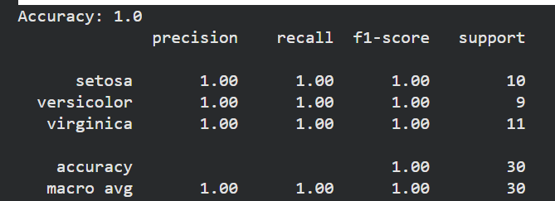
Model Accuracy
The trained model achieved high classification accuracy on test data.

Slide 9
Conclusion
Conclusion
Successfully developed a Machine Learning model capable of classifying iris flower species with high accuracy.
The project demonstrates:
Data Analysis
Visualization
Model Training
Predictive Classification

Slide 10
Thank You

